Slide 1

Vaishnavi C. Badgujar
HR Data Analysis
using MS-Excel and Power BI
Pysliq Internship Project

Slide 2
Introduction
Embarking on a data-driven journey, I've meticulously dissected a dataset using the dynamic duo of Microsoft Excel and Power BI. Unveiling hidden patterns and trends, this analysis showcases the synergy between Excel's versatility and Power BI's robust visualization capabilities. From meticulous data cleaning to insightful visualizations, join me in unravelling the compelling story woven into this dataset through the lens of Excel and Power BI

Slide 3
Project Questions
And Solutions

Slide 4
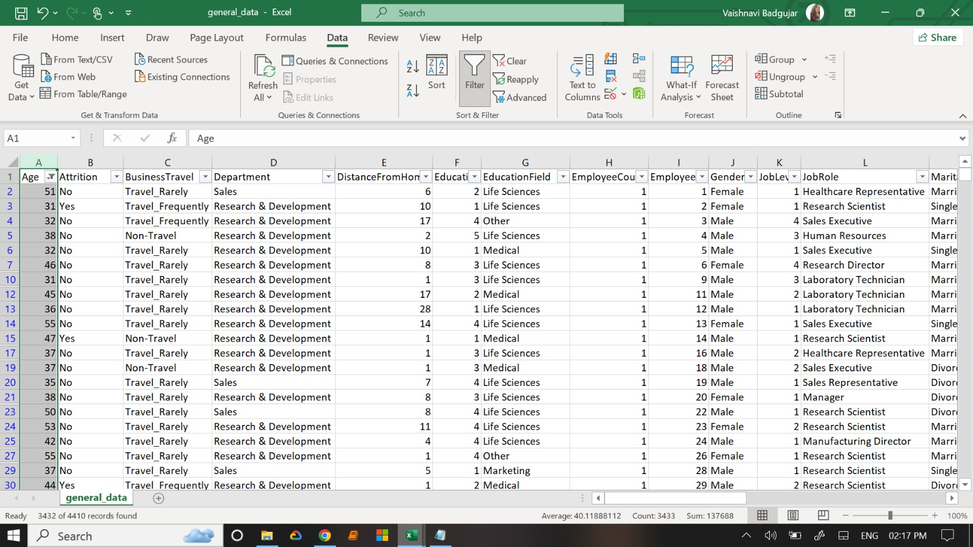
Using Excel, how would you filter the dataset to only show employees aged 30 and above?
Ans. : Select Age Column, apply filter then click number filter then greater than equal to ‘30’.

Slide 5
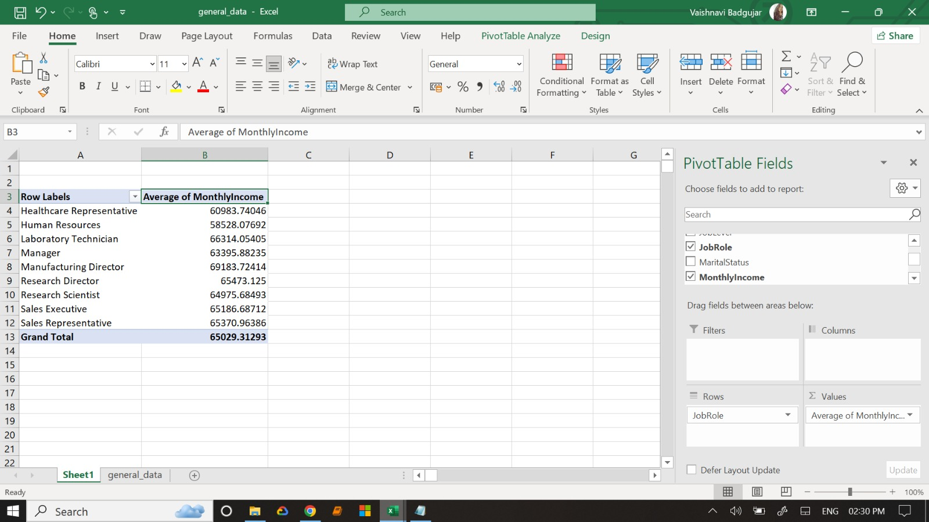
2. Create a pivot table to summarize the average Monthly Income by Job Role.

Slide 6
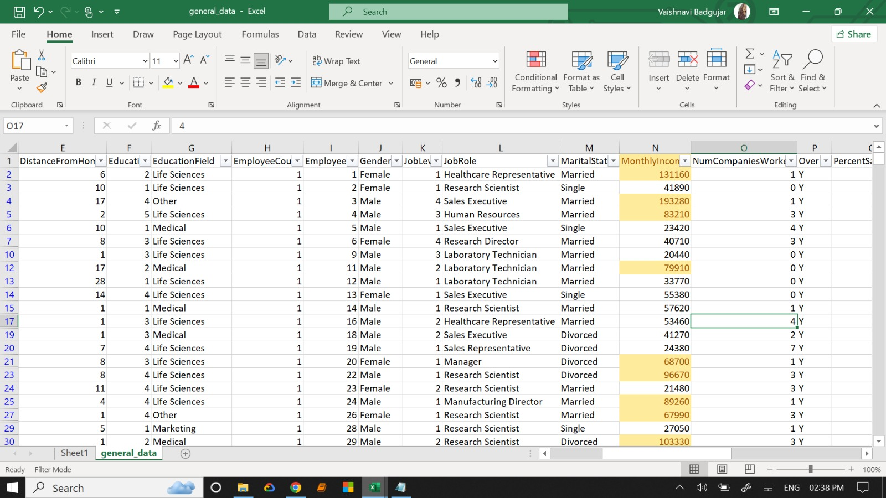
3. Apply conditional formatting to highlight employees with Monthly Income above the
company's average income.

Slide 7
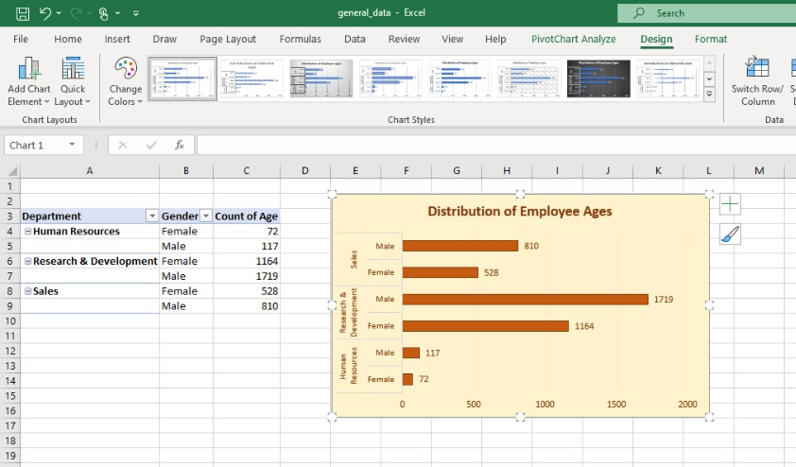
4. Create a bar chart in Excel to visualize the distribution of employee ages.

Slide 8
5. Identify and clean any missing or inconsistent data in the "Department" column.
Ans. Select Department column, click on home then in editing group click find & select then go to special, click blanks, there is not any missing or inconsistent data in "Department" column.

Slide 9
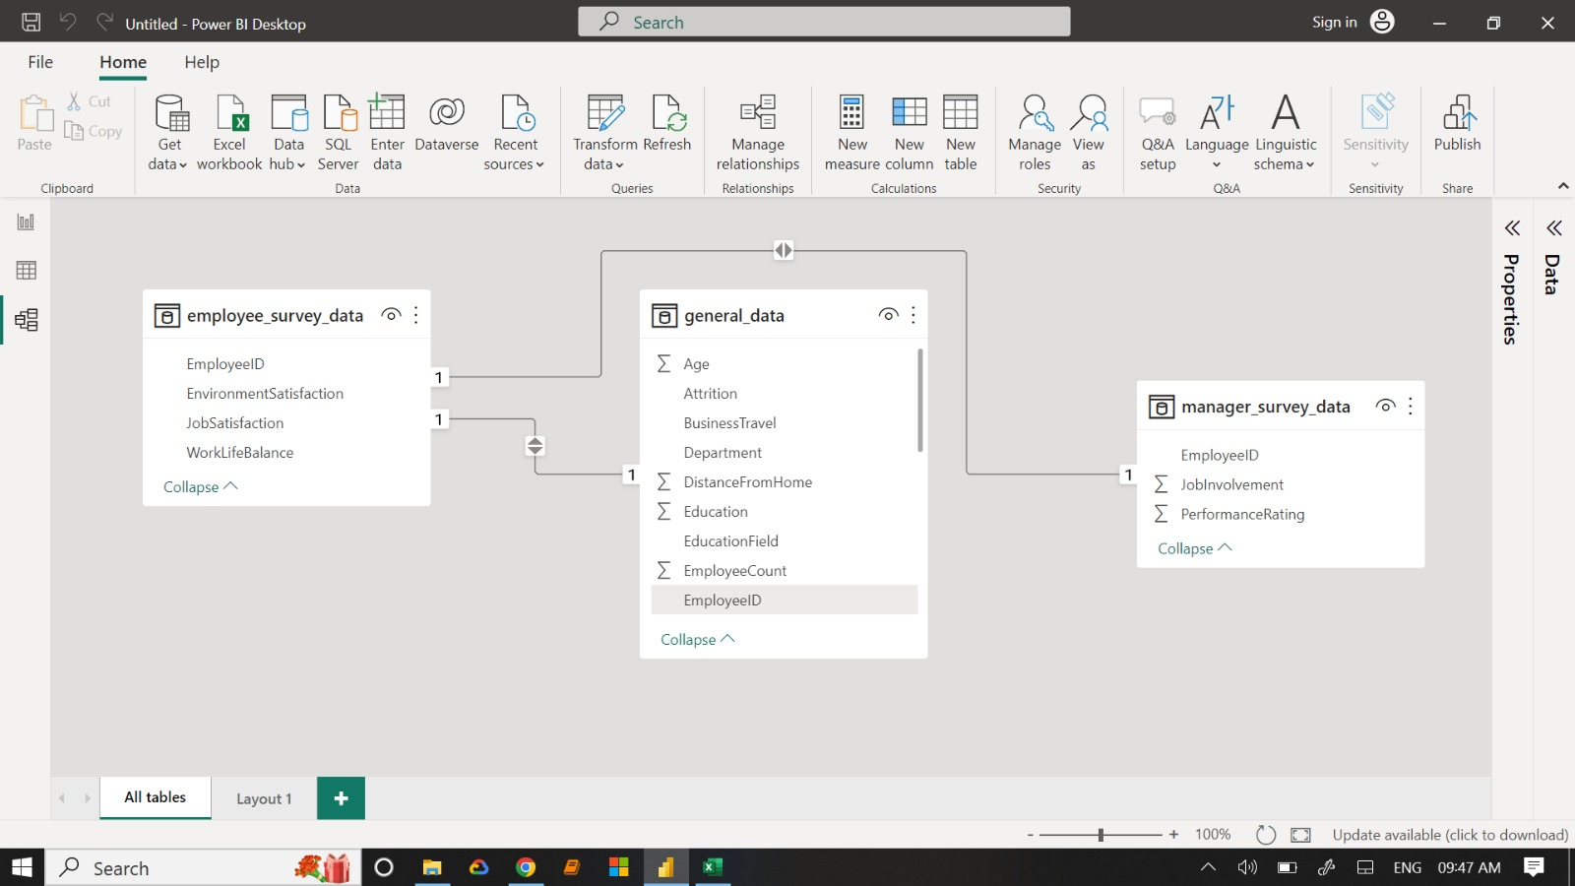
6. In Power BI, establish a relationship between the "EmployeeID" in the employee data and the "EmployeeID" in the time tracking data.

Slide 10
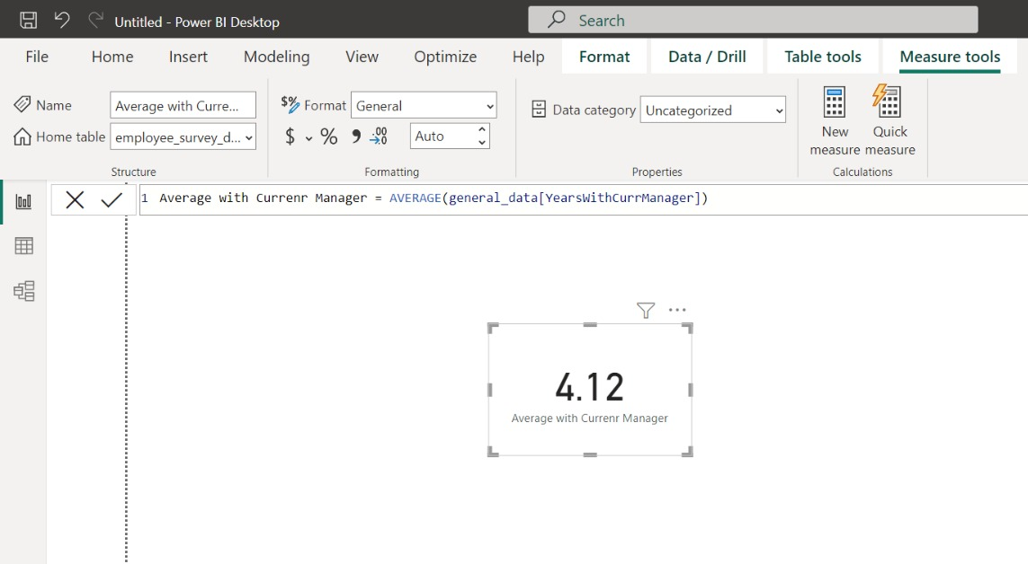
7. Using DAX, create a calculated column that calculates the average years an employee has spent with their current manager.

Slide 11
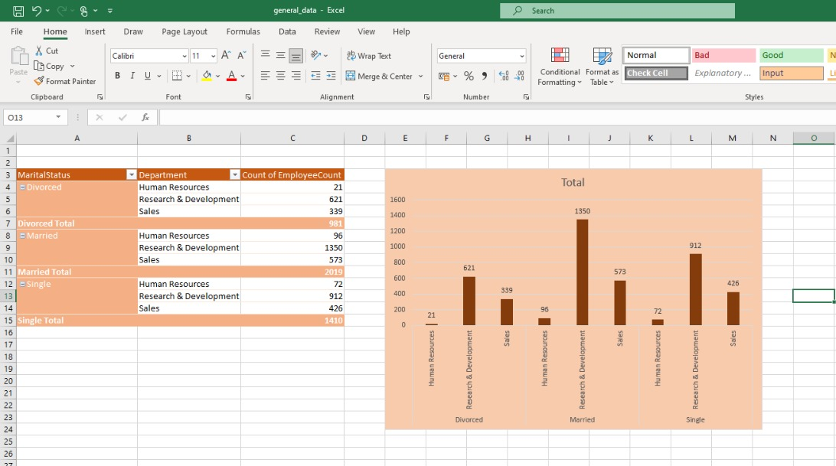
8. Using Excel, create a pivot table that displays the count of employees in each Marital Status category, segmented by Department.

Slide 12
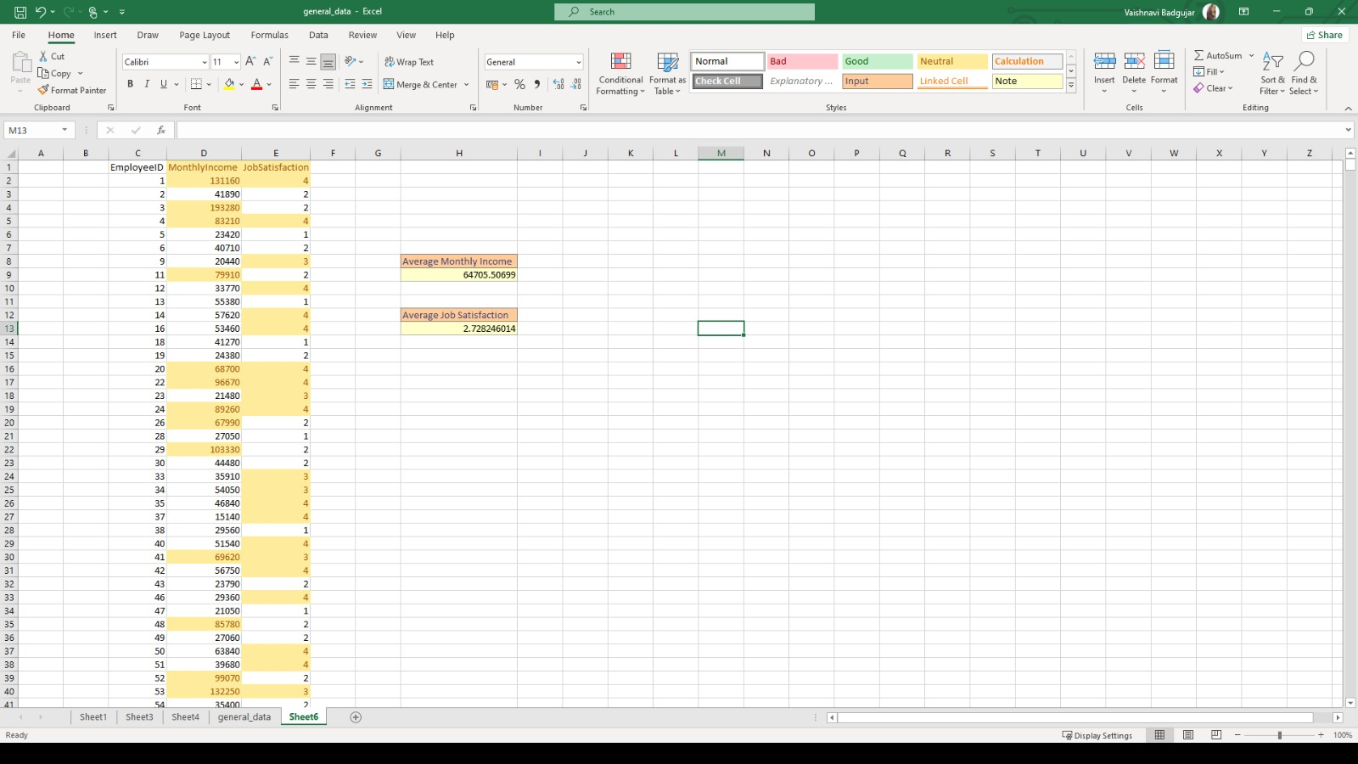
9. Apply conditional formatting to highlight employees with both above-average Monthly Income and above-average Job Satisfaction.

Slide 13
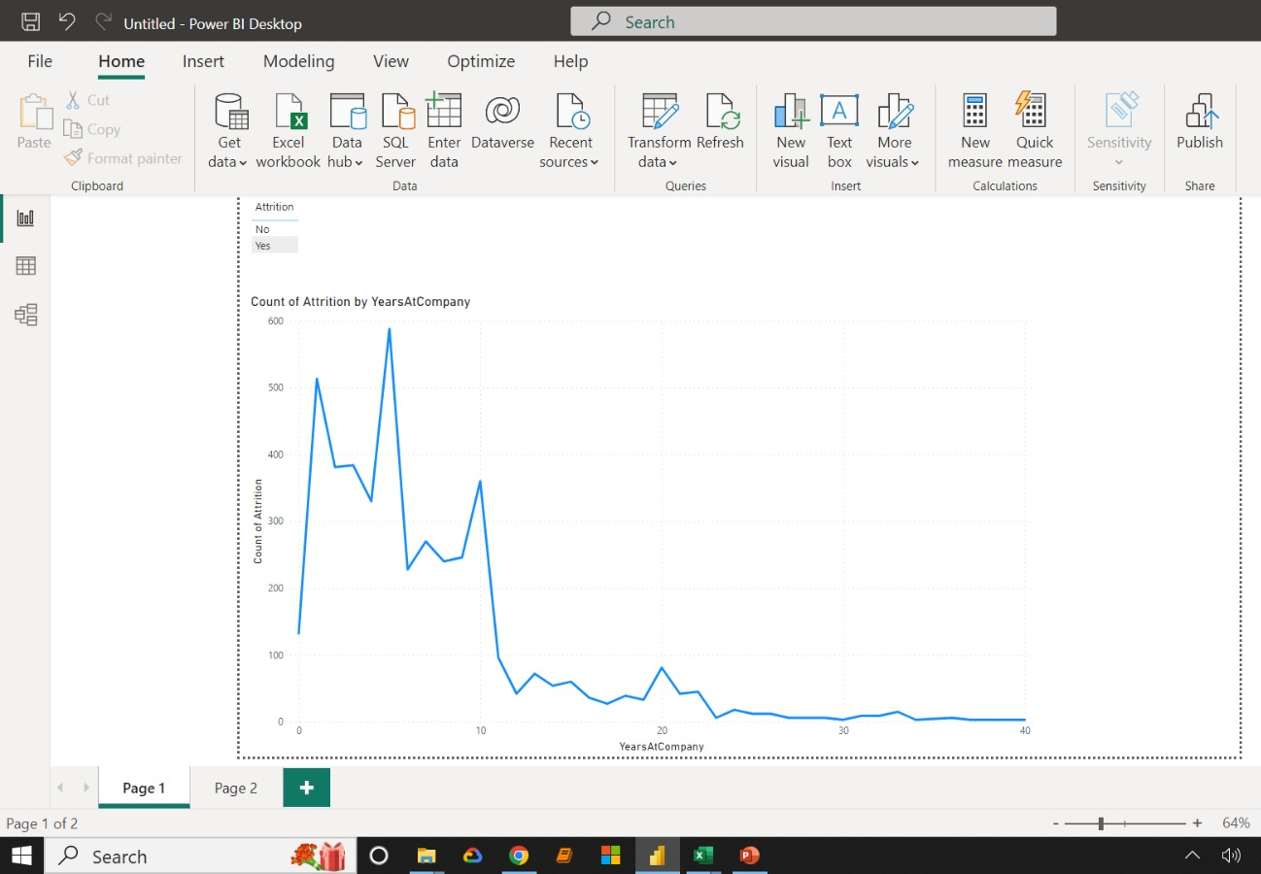
10.In Power BI, create a line chart that visualizes the trend of Employee Attrition over the years.

Slide 14
11. Describe how you would create a star schema for this dataset, explaining the benefits of doing so.
We can use Power BI data modelling to create star schema. It involves structuring it into a central fact table and related dimension tables.
Fact Table : The central fact table is general_data.
2. Dimension Tables : Employee_survey_data, manager_survey_data, in_time, out_time.
▪ Benefits of Star Schema:
• Performance Improvement : Optimizes query performance by minimizing redundant data.
• Ease of Maintenance : Simplifies updates as changes are confined to dimension tables.
• Enhanced Query Clarity : Facilitates clearer, more straightforward queries due to well-defined relationships.
• Scalability : Provides scalability as additional dimensions can be easily incorporated.

Slide 15
12. Using DAX, calculate the rolling 3-month average of Monthly Income for each employee.
RollingAvgMonthlyIncome =
CALCULATE(
AVERAGE(EmployeeTable[MonthlyIncome]),
FILTER(
ALL(EmployeeTable),
EmployeeTable[EmployeeID] = EARLIER(EmployeeTable[EmployeeID]) && EmployeeTable[DateColumn] <= EARLIER(EmployeeTable[DateColumn]) && EmployeeTable[DateColumn] > DATEADD(EARLIER(EmployeeTable[DateColumn]), -3, MONTH)
)
)

Slide 16
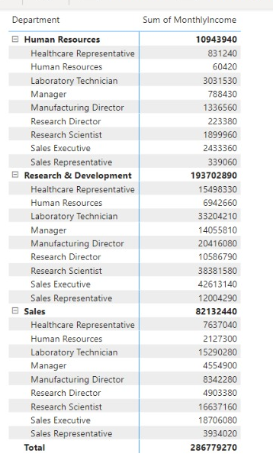
13. Create a hierarchy in Power BI that allows users to drill down from Department to Job Role to further narrow their analysis.
Step 1 : We use hierarchy in Power BI using MATRIX. First Select a Matrix.
Step 2 : Dragged and dropped Department and JobRole into rows section and MonthlyIncome in values section.
Step 3 : Use the + icon in the matrix view to see the hierarchy.

Slide 17
14. How can you set up parameterized queries in Power BI to allow users to filter data based 2 of 2 on the Distance from Home column?
Create a Parameter:
● Go to the Data pane and click the dropdown arrow in the upper right corner.
● Select "Create Parameter."
● In the Create Parameter dialog box, enter a descriptive name like "DistanceFromHomeFilter."
● Choose the appropriate data type (likely Number or Integer).
● Specify allowable values (e.g., a list of distances or a range).
2. Apply the parameter to a filter:
● Drag the "Distance from Home" field (or the calculated field) to the Filters shelf.
● In the Edit Filter dialog box, select "Condition."
● Choose a comparison operator (e.g.,"is less than or equal to").
● In the value field, type the parameter name enclosed in square brackets:[DistanceFromHomeFilter]
3. Display the Parameter Control:
● Right-click the parameter in the Data pane and choose "Show Parameter Control."
● This will create a visual element (e.g., slider, dropdown) on the dashboard that users can interact with to adjust the filter value.

Slide 18
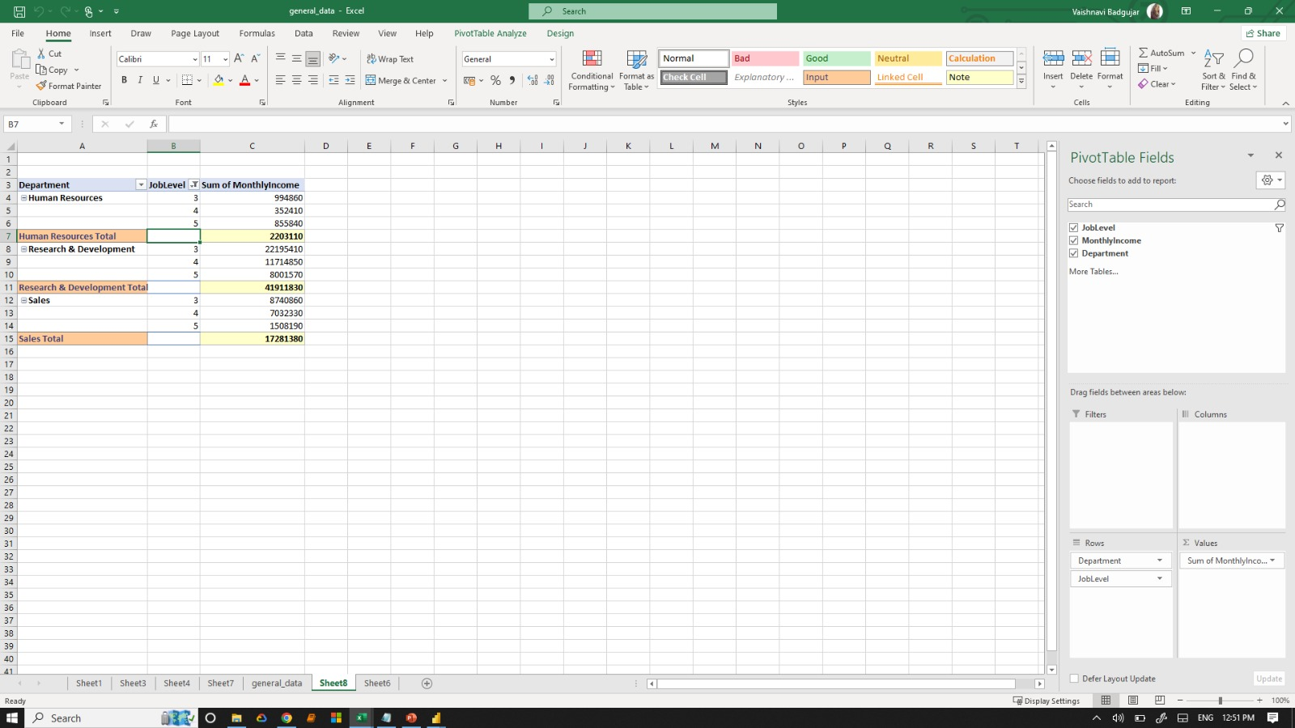
15. In Excel, calculate the total Monthly Income for each Department, considering only the employees with a Job Level greater than or equal to 3.

Slide 19
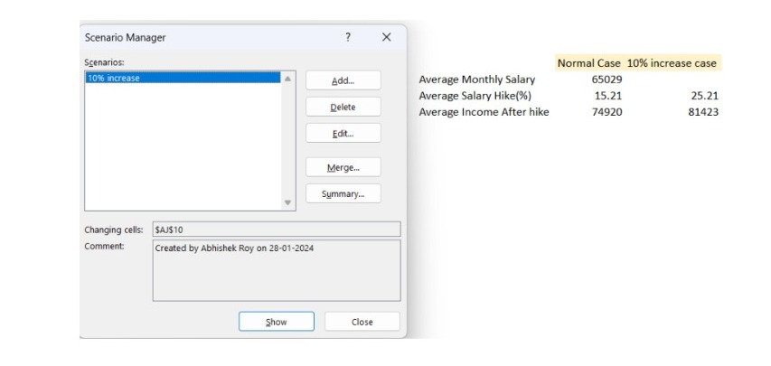
16. Explain how to perform a What-If analysis in Excel to understand the impact of a 10% increase in Percent Salary Hike on Monthly Income.
Should the average Salary Hike experience a 10% increase, the corresponding adjustment would require the Average salary to rise by 6503.

Slide 20
17. Verify if the data adheres to a predefined schema. What actions would you take if you find inconsistencies?
Review the data to find any fields, values or formats that deviate from the predefined schema.
Document the inconsistencies, noting the specific fields or records that don’t adhere to the specific schema.
Understand the reasons behind the inconsistencies. It could be data entry errors, system issues or changes in source systems.
Set up validation rules to prevent future inconsistencies. This ensures that new data entering the system conforms to the defined schema.
Implement ongoing monitoring processes to catch and rectify inconsistencies early on, maintaining data quality over time.
Update documentation to reflect any changes made to the schema or validation rules.
Establish a continuous improvement process to regularly review and enhance data quality measures.

Slide 21
INSIGHTS
➢ Data Overview : In Our workforce, there are 2,646 males and 1,764 females contributing to a total monthly income of $286,779,270. The average monthly income for employees is a noteworthy $65,029.
➢ Workforce Statistics : The workforce experiences an average attrition rate of 16.1% coupled with an average salary hike of 15.21%. Moreover, majority of employees needs to travel rarely.
➢ Departmental Distribution : There are 3 departments named R&D, Sales and HR with almost 65% of employees belonging to R&D.
➢ Employee Insights : The average job satisfaction score stands at 2.72 on a scale of 4. Employees rate their work-life balance at 2.8 on a scale of 4.
➢ Marital Status : 46% of the workforce are married, 32% single and 22% divorced.
➢ Managerial Insights : Managers exhibits an overall job involvement of 2.72% and their performance is reflected in an average rating of 3.15.

